Slide 1
Regression
Linear Regression
Calculations Involved in Linear Regression
Partitioning Sums of Squares in Regression: SSY = SSR + SSE
Measuring the Degree of Fit, r²
Model Checking
Transformation
Polynomial Regression
Non-Linear Regression
Generalized Additive Models
Influence

Slide 2
Regression
The simplest model of all is the linear model: y = a + bx
The response variable is y, and x is a continuous explanatory variable. There are two parameters, a and b: the intercept is a (the value of y when x= 0); and the slope is b (the slope, or gradient, is the change in y divided by the change in x which brought it about). The slope is so important that it is worth drawing a picture to make clear what is involved.

Slide 3
Regression
Estimating the slope is slightly more involved because we need to calculate
change in y/ change in x that brought it about.
In practice, it is a good idea for precision to select a large change in x. Let us take it from2 to 8. Because the slope of the graph is negative, the value of y is lower when x= 8 than it is when x= 2. At x= 2, we draw a blue line vertically downwards from the regression line to the value of y when x=8. The length of this blue line is the change in y (often denoted as ‘delta y’, orΔy in symbols). Now we draw a horizontal brown line showing the change in x from 2 to 8. The length of this brown line isΔx. When x= 2 we can read off the value of y (approximately) from the graph: it is roughly 66. Similarly, when x= 8 we can read off the value of y as 24.

Slide 4
Regression
So the change in x is +6 (from 2 up to 8) and the change in y is 42 (from 66 down to 24).
Finally, we can calculate the slope of the straight line, b:
b = change in y/change in x
.= (24 -66)/(8-2)
=42/6 =. 7:0
We now know both of the parameter values of the line: the intercept a= 80 and the slope
b= 7.0. We can write the parameterized equation like this:
y = 80 -7x

Slide 5
Regression
We can predict values of y at x values we have not measured (say, at x =10.5):
y = 80 – 7.0 * 10:5 = 6:5
We can also ask what x values are associated with particular values of y (say, y =40). This is
a bit more work, because we have to rearrange the equation
40 = 80 - 7.0x
First, subtract 80 from both sides
40 - 80 = 7.0x
then divide both sides by 7 to find the value of x:
x = (40 – 80)/-7
=-40/-7
=5:714286

Slide 6
Linear Regression
reg.data <- read.csv("c:\\temp\\tannin.csv")
attach(reg.data)
names(reg.data)
[1] "growth" "tannin"
plot(tannin,growth,pch=21,bg="blue")
What is the value of y when x=0? It is about 12, so the
intercept is roughly a≈12. Finally, what is the value of b?
It is the change in y (10) divided by the change in x which brought it about (8), so b≈10/8 =1.25.
So our rough guess at
the regression equation is
y = 12.0 – 1.25x

Slide 7
Linear Regression in R
lm(growth∼tannin)
Coefficients:
(Intercept) tannin
11.756 -1.217
The two parameters are called Coefficients in R:
the intercept is 11.756 (compared with out guesstimate
of 12), and the slope is 1.217 (compared with our
guesstimate of 1.25). Not bad at all.

Slide 8
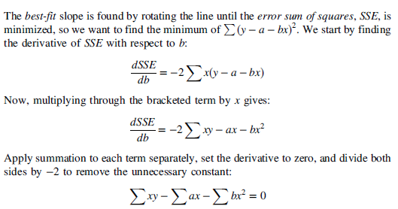
The least-squares estimate of the regression slope, b

Slide 9
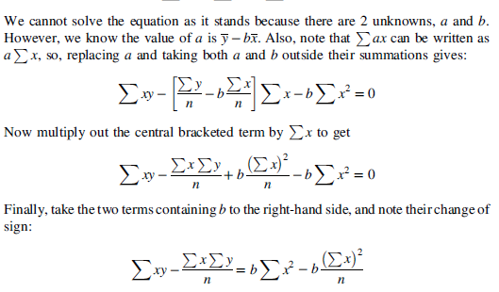
The least-squares estimate of the regression slope, b

Slide 10
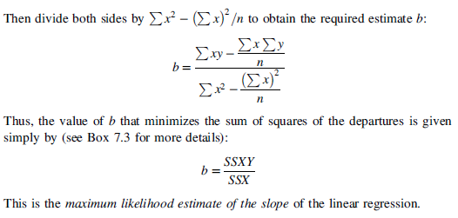
The least-squares estimate of the regression slope, b

Slide 11
Linear Regression in R
abline(lm(growth∼tannin),col="green")
fitted <- predict(lm(growth∼tannin))
fitted
1 2 3 4 5 6 7 8 9
11.755556 10.538889 9.322222 8.105556 6.888889 5.672222 4.455556 3.238889 2.022222
So the first predicted value of growth is 11.755556 when tannin = 0. To draw the first residual, both x coordinates will be 0. The first y coordinate will be 12 (the observed value) and the second will be 11.755556 (the fitted (or predicted) value). We use lines, like this:
lines(c(0,0),c(12,11.755556))
We could go through, laboriously, and draw each residual like this. But it is much quicker to automate the procedure, using a loop to deal with each residual in turn:
for (i in 1:9)
lines (c(tannin[i],tannin[i]),c(growth[i],fitted[i]),col="red")

Slide 12
Linear Regression in R
These residuals describe the goodness of fit of the regression line. Our maximum likelihood model is defined as the model that minimizes the sum of the squares of these residuals. It is useful, therefore, to write down exactly what any one of the residuals, d, is: it is the measured value, y, minus the fitted value called ^y (y ‘hat’):
d= y-yhat
We can improve on this, because we know that ^y is on the straight line a + bx, so
d =y -(a + bx.)= y - a - bx

Slide 13
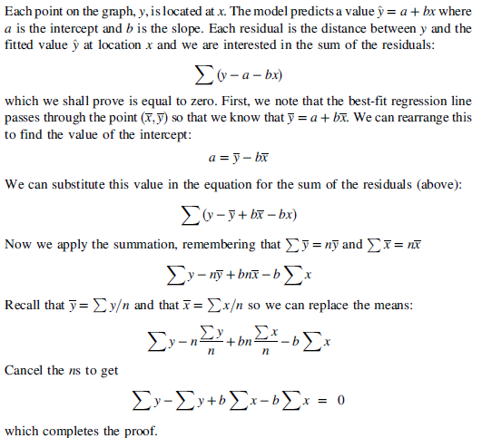
The sum of the residuals in a linear regression is zero

Slide 14
Linear Regression in R
• change the value of the slope b
• work out the new intercept a = yhat - bxhat
• predict the fitted values of growth for each level of tannin a + bx
• work out the residuals y - a - bx
• square them and add them up sigma( y - a -bx²⁾
• associate this value of sse[i] with the current estimate of the slope b[i]
Once this process is complete, we can produce a U-shaped graph with the squared residuals on the y axis and the estimate of the slope on the x axis. Now we find the minimum value of sse (it turns out to be 20.072) and draw a horizontal dashed green line. At the point where this minimum touches the graph, we read down to the x axis to find the best value of the slope (the red arrow). This is the value (b =1.217) that R provided for us earlier.

Slide 15
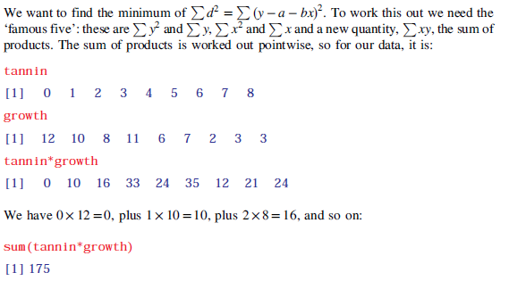
Calculations Involved in Linear Regression
Here is the R code that produces the figure and extracts the best estimate of b:
b <- seq(-1.43,-1,0.002)
sse <- numeric(length(b))
for (i in 1:length(b)) {
a <- mean(growth)-b[i]*mean(tannin)
residual <- growth - a - b[i]*tannin
sse[i] <- sum(residual^2)
}
plot(b,sse,type="l",ylim=c(19,24))
arrows(-1.216,20.07225,-1.216,19,col="red")
abline(h=20.07225,col="green",lty=2)
lines(b,sse)
b[which(sse==min(sse))]

Slide 16

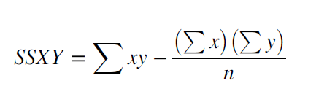
Calculations Involved in Linear Regression
The corrected sums of squares of y and x
The corrected sum of products

Slide 17
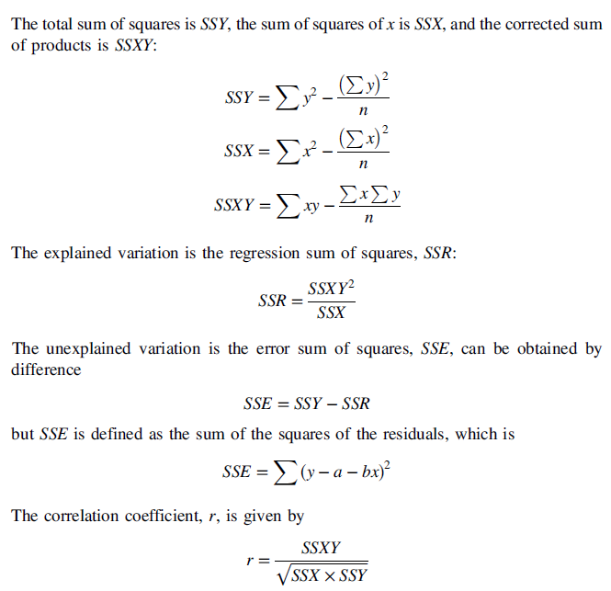
Corrected sums of squares and products in regression

Slide 18
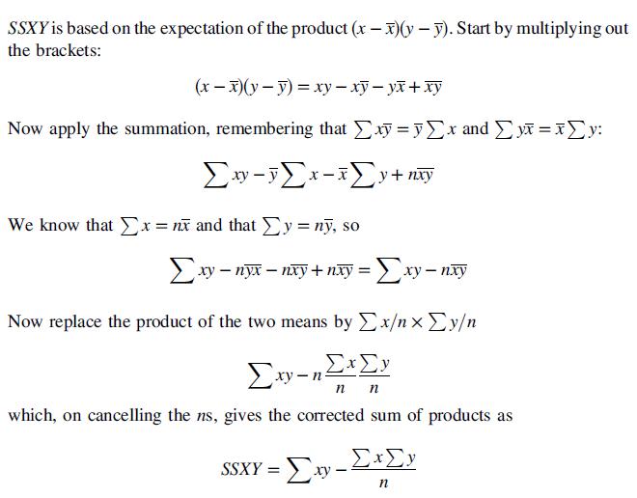


The shortcut formula for the sum of products, SSXY

Slide 19
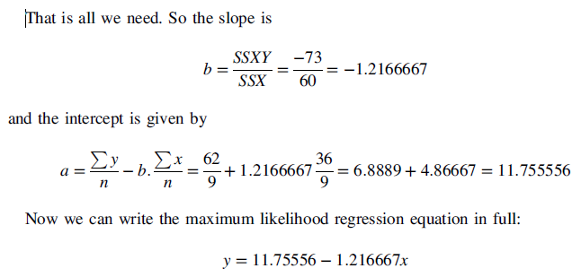
The shortcut formula for the sum of products, SSXY
SSX <- sum(tannin^2)-sum(tannin)^2/length(tannin)
SSX
[1] 60
SSY <- sum(growth^2)-sum(growth)^2/length(growth)
SSY
[1] 108.8889
SSXY <- sum(tannin*growth)-sum(tannin)*sum(growth)/length(tannin)
SSXY
[1] -73

Slide 20
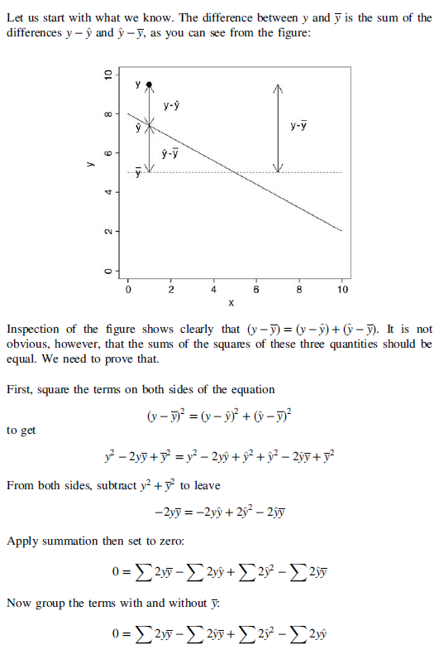
Proof that SSY=SSR+SSE

Slide 21
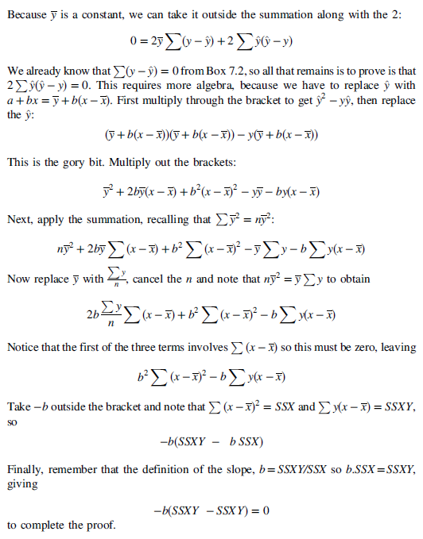
Proof that SSY=SSR+SSE

Slide 22
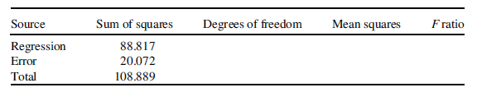

Calculations Involved in Linear Regression
To complete the ANOVA table, we need to understand the fourth column, headed ‘Mean
squares’. This column contains the variances, on which analysis of variance is based. The
key point to recall is that

Slide 23
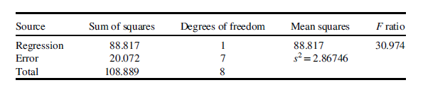
Calculations Involved in Linear Regression
qf(0.95,1,7)
[1] 5.591448
1-pf(30.974,1,7)
[1] 0.0008460725

Slide 24

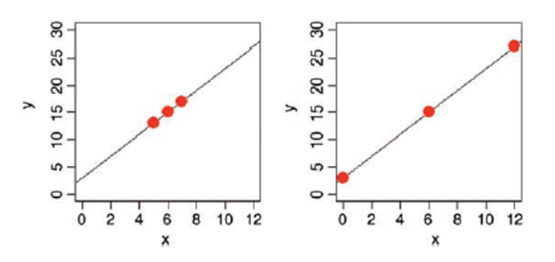

The standard error of the regression slope
This quantity is given by

Slide 25

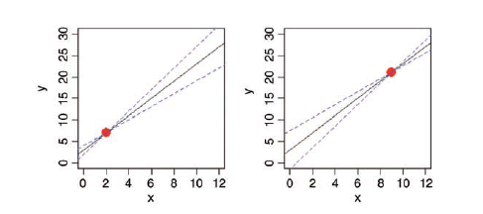

The standard error of the intercept
This quantity is given by
In general, the standard error for a predicted value ^y is given by:

Slide 26
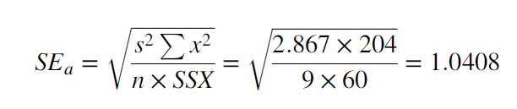
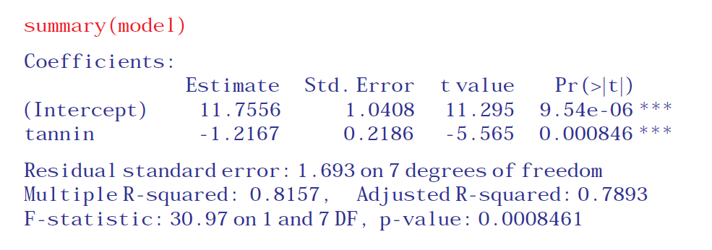
The standard error of the intercept
The formula for the standard error of the intercept is a little more involved
model <- lm(growth∼tannin)

Slide 27
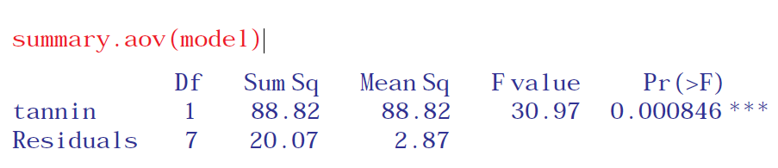
The standard error of the intercept
If you want to see the ANOVA table rather than the parameter estimates, then the
appropriate function is summary.aov:

Slide 28

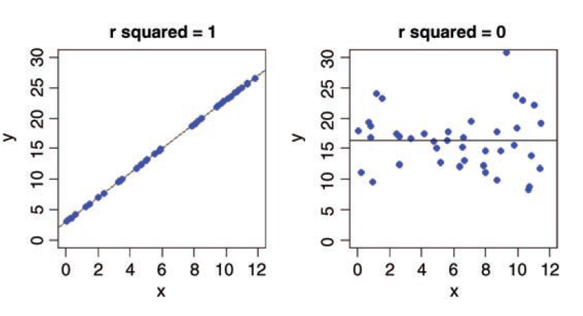
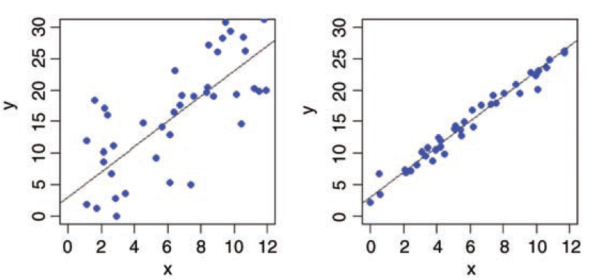
Measuring the Degree of Fit, r²
Two regression lines can have exactly the same slopes and intercepts, and yet be derived from completely different
relationships:
This varies from 1, when the regression explains all of the variation in y (SSR =SSY), to 0 when the regression explains none of the variation in y (SSE = SSY).

Slide 29
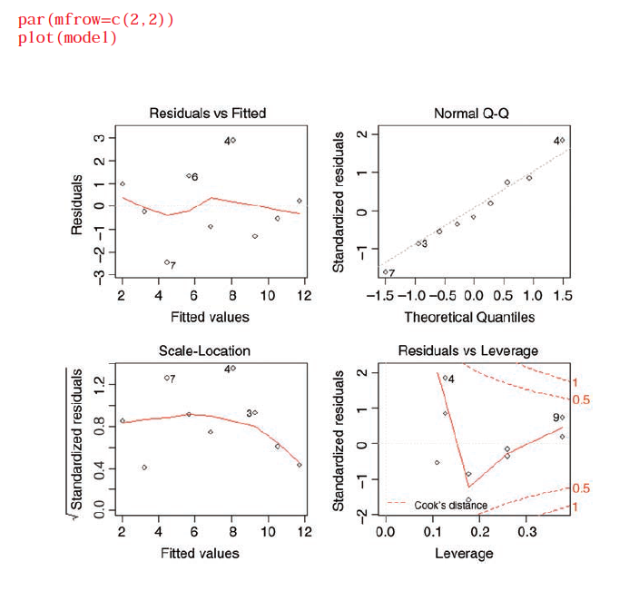
Model Checking
The final thing you will want to do is to expose the model to critical appraisal. The assumptions we really want to be sure about are constancy of variance and normality of errors. The simplest way to do this is with four built-in model-checking plots:

Slide 30
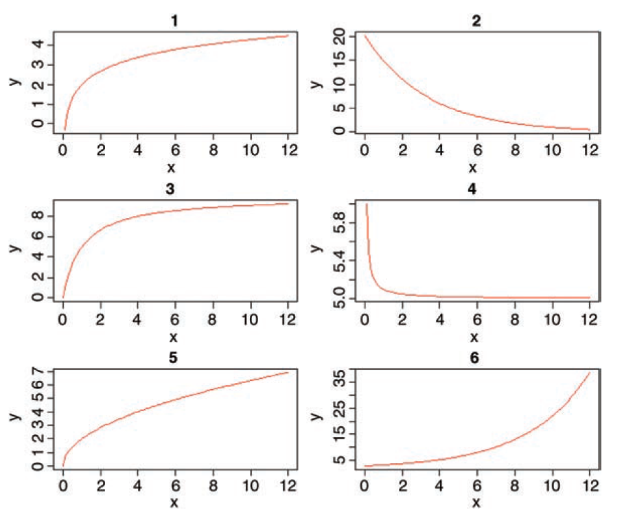
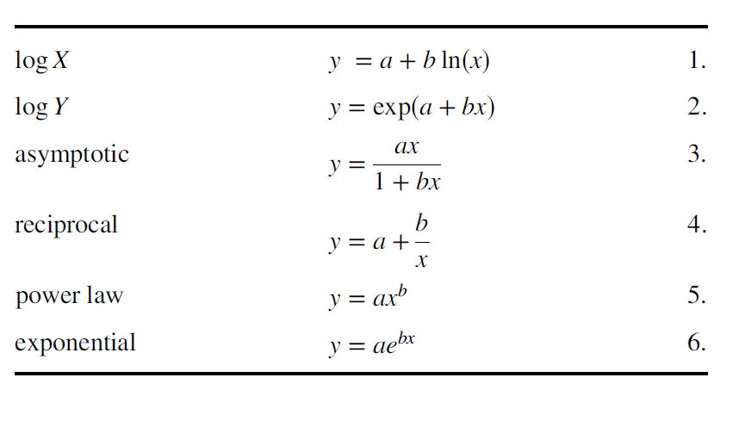
Transformation
Here are some other useful two-parameter models:

Slide 31
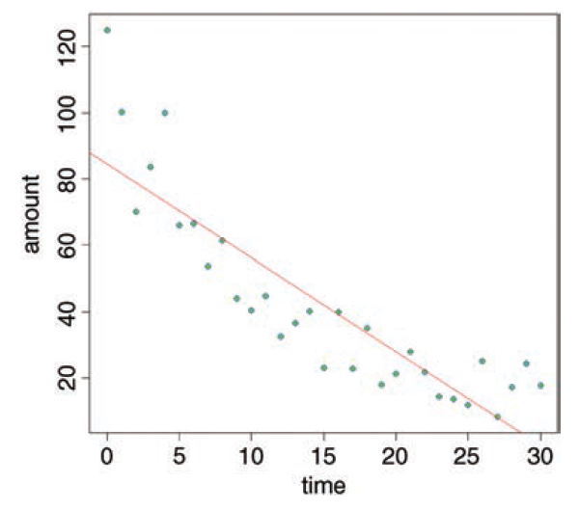
Transformation
par(mfrow=c(1,1))
data <- read.csv("c:\\temp\\decay.csv")
attach(data)
names(data)
[1] "time" "amount“
plot(time,amount,pch=21,col="blue",bg="green")
We start by fitting a straight line through the scatterplot, using abline with a linear model:
abline(lm(amount∼time),col="red")

Slide 32
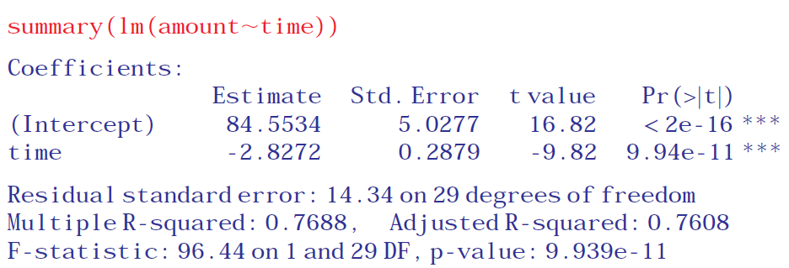
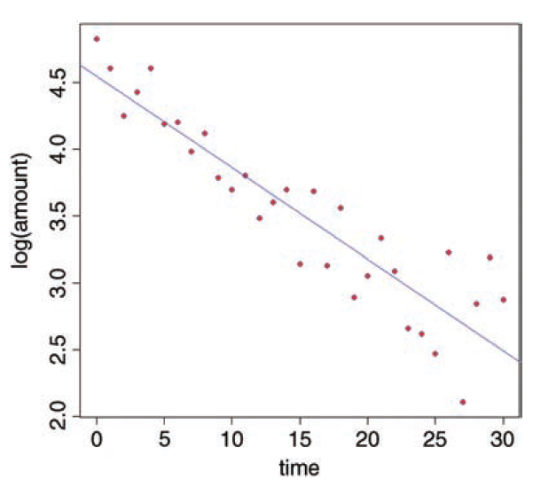
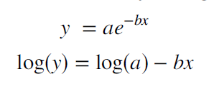

Transformation
plot(time,log(amount),pch=21,col="blue",bg="red")
abline(lm(log(amount)∼time),col="blue")

Slide 33
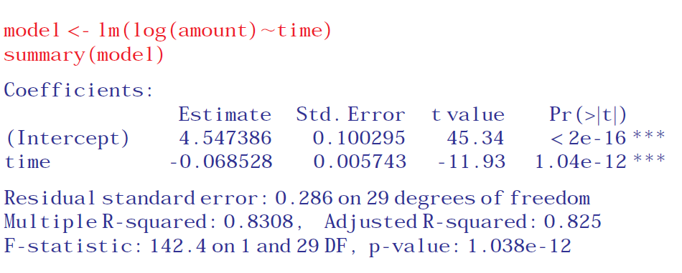
Transformation
Let us add one standard error to the intercept and subtract one standard error from it to get upper and lower intervals:
upper <- 4.547386 + 0.100295
lower <- 4.547386 - 0.100295
Now we return to the original scale of measurement by taking antilogs using exp:
exp(upper)
[1] 104.3427
exp(lower)
[1] 85.37822
so the intercept on the original axis is between 85.38 and 104.34, but the best estimate for the
intercept is
exp(4.547386)
[1] 94.38536
which means that the interval above the intercept is 9.957 but the interval below it is 9.007.
which means that the interval above the intercept is 9.957 but the interval below it is
9.007.

Slide 34
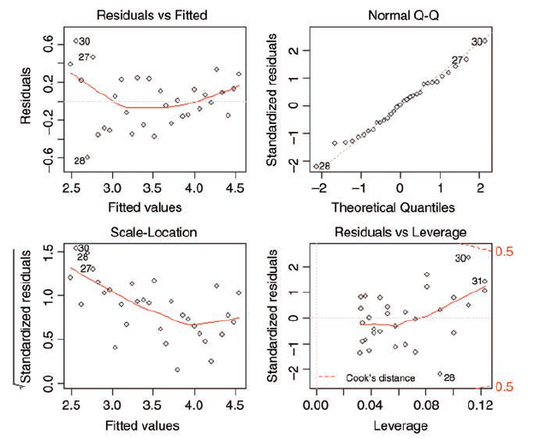
Transformation
Now we check the assumptions of the model using plot(model):
par(mfrow=c(1,1))
plot(time,amount,pch=21,col="blue",bg="green")
xv <- seq(0,30,0.25)
yv <- 94.38536 * exp(-0.068528 * xv)

Slide 35
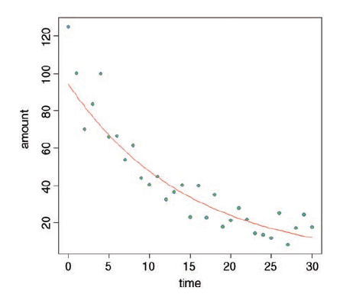
Transformation
Now we use the lines function to add the curve to the scatterplot:
lines(xv,yv,col="red")

Slide 36
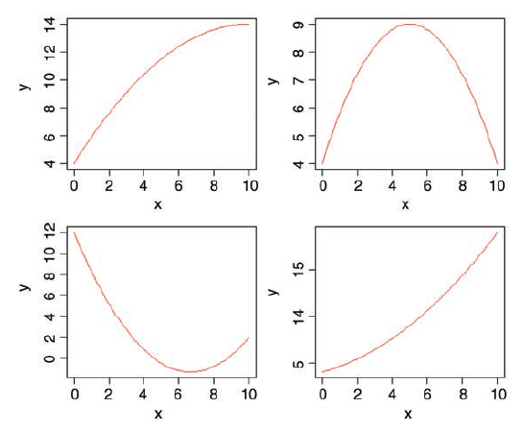
Polynomial Regression
One of the simplest ways is to use polynomial regression y = a + bx + cx² + dx³ . . . .
par(mfrow=c(2,2))
curve(4+2*x-0.1*x^2,0,10,col="red",ylab="y")
curve(4+2*x-0.2*x^2,0,10,col="red",ylab="y")
curve(12-4*x+0.3*x^2,0,10,col="red",ylab="y")
curve(4+0.5*x+0.1*x^2,0,10,col="red",ylab="y")

Slide 37
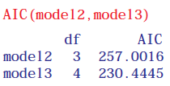
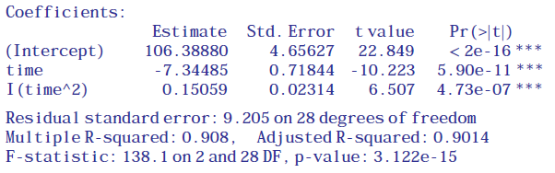
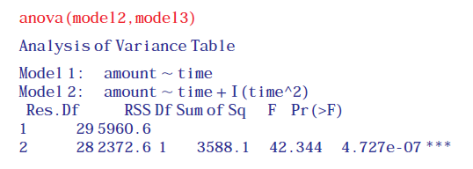
Polynomial Regression
model2 <- lm(amount∼time)
model3 <- lm(amount∼time+I(time^2))
summary(model3)

Slide 38
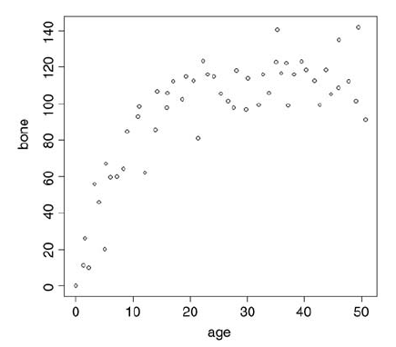

Non-Linear Regression
y = a – be^{-cx}
exp(-Inf)
[1] 0
exp(-0)
[1] 1
Here are the data on bone length as a function of age:
deer <- read.csv("c:\\temp\\jaws.csv")
attach(deer)
names(deer)
[1] "age" "bone"
par(mfrow=c(1,1))
plot(age,bone,pch=21,bg="lightgrey")
Inspection suggests that a reasonable estimate of the asymptote is a≈120 and intercept≈10, so b = 120 -10 =110. Our guess of the value of c is slightly harder. Where the curve is rising most steeply, jaw length is about 40 where age is 5; rearranging the equation gives

Slide 39

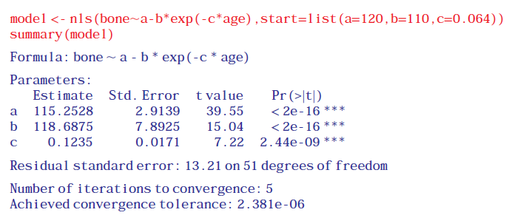
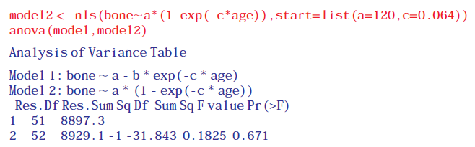
Non-Linear Regression
Now that we have the three parameter estimates, we can provide them to R as the starting conditions as part of the nls call like this: list(a = 120, b = 110, c = 0.064)
Try fitting the simpler two-parameter model

Slide 40
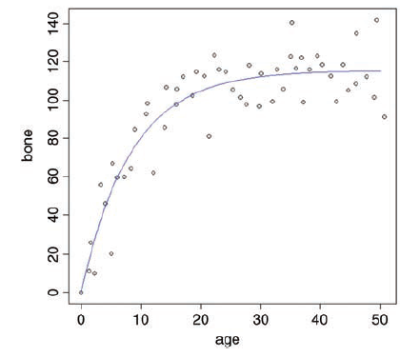
Non-Linear Regression
Model simplification was clearly justified (p= 0.671), so we accept the two-parameter version, model2, as our minimal adequate model. We finish by plotting the curve through the scatterplot. The age variable needs to go from 0 to 50:
av <- seq(0,50,0.1)
and we use predict with model2 to generate the predicted bone lengths:
bv <- predict(model2,list(age=av))
Note the use of list to assign our steps along the x axis (called av) to the variable used
for the x axis in model2 (called age)
lines(av,bv,col="blue")

Slide 41
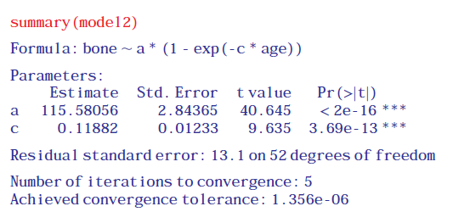
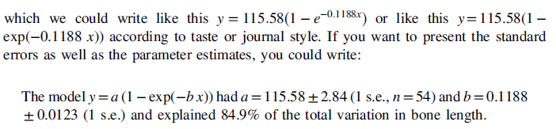
Non-Linear Regression
The parameters of this curve are obtained from model2:The parameters of this curve are obtained from model2:

Slide 42
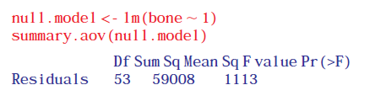
Non-Linear Regression
The key figure to extract from this is the total sum of squares SSY= 59 008. The nonlinear output (above) did not give us either SSE or SSR but it did print:
Residual standard error: 13.1 on 52 degrees of freedom
100*(59008-8923.72)/59008
[1] 84.8771

Slide 43
Generalized Additive Models
library(mgcv)
hump <- read.csv("c:\\temp\\hump.csv")
attach(hump)
names(hump)
[1] "y" "x“
We start by fitting the generalized additive model as a smoothed function of x, s(x):
model <- gam(y∼s(x))
Then we plot the model, and overlay the scatterplot of data points:
plot(model,col="blue")
points(x,y-mean(y),pch=21,bg="red")

Slide 44
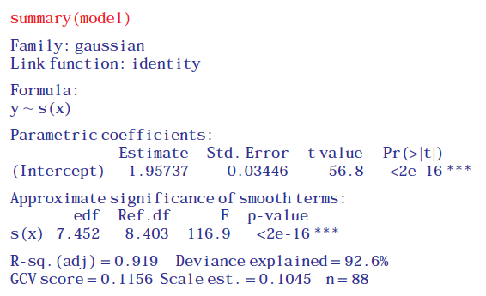
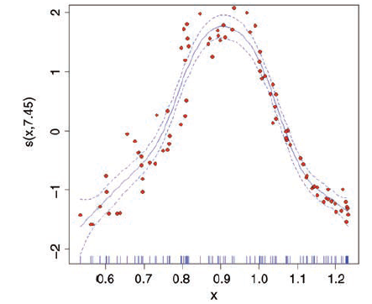
Generalized Additive Models

Slide 45
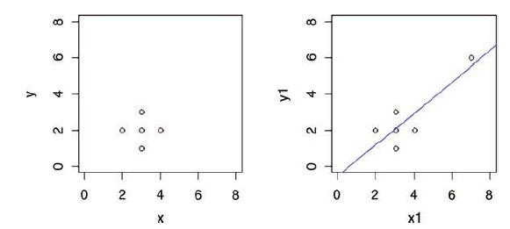
Influence
x <- c(2,3,3,3,4)
y <- c(2,3,2,1,2)
We want to draw two graphs side by side, and we want
them to have the same axis scales:
windows(7,4)
par(mfrow=c(1,2))
plot(x,y,xlim=c(0,8),ylim=c(0,8))
Obviously, there is no relationship between y and x in the
original data. But let’s add an outlier at the point (7,6)
using concatenation c and see what happens.
x1 <- c(x,7)
y1 <- c(y,6)
plot(x1,y1,xlim=c(0,8),ylim=c(0,8))
abline(lm(y1∼x1),col="blue")

Slide 46

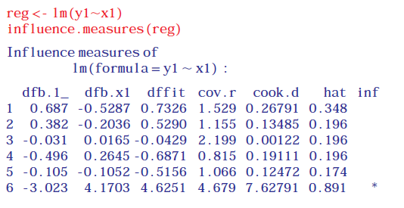

Influence
Measures of leverage for a given data point y are proportional to (x – xbar)². The commonest measure of leverage is
where the denominator is SSX. A good rule of thumb is that a point is highly influential if its
where p is the number of parameters in the model. There is a useful function called influence.measures which highlights influential points in a given model

